Slide 1
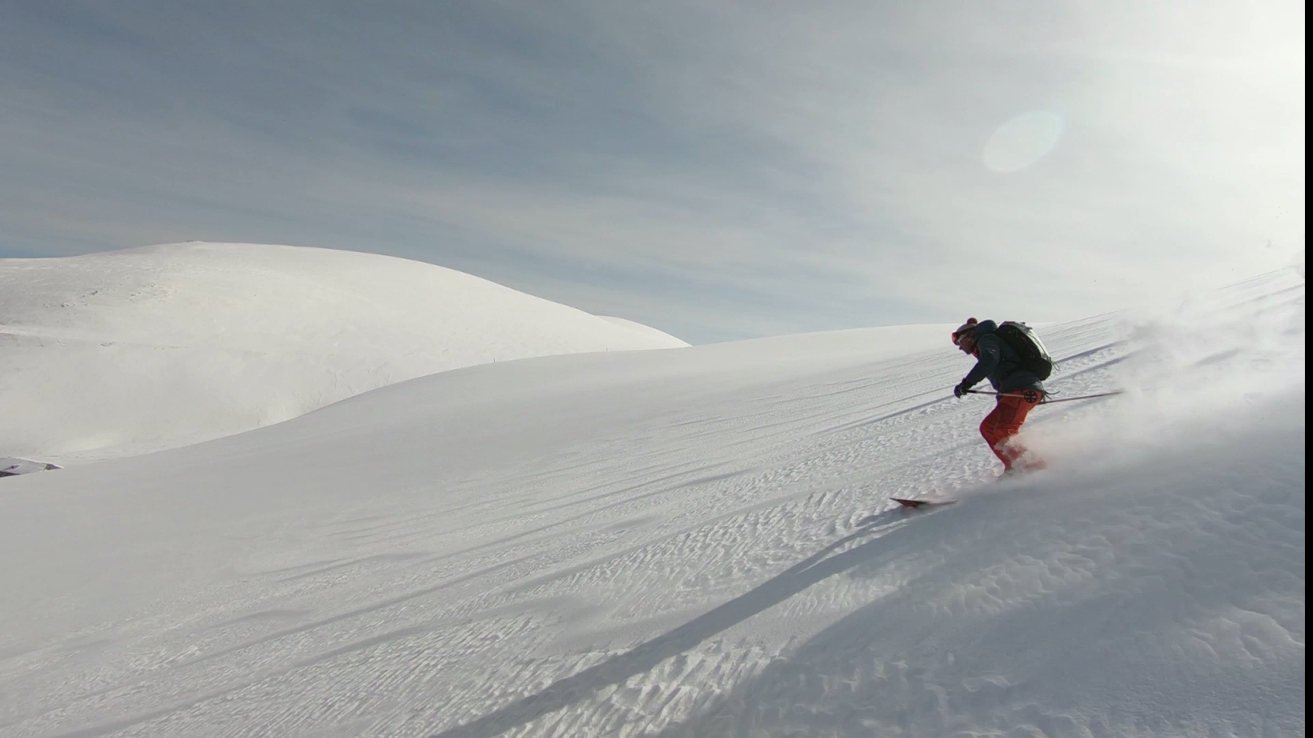
Company Analysis Vail Resorts Inc
Final Project
ACC 652 Group 5
Ber, Caleb, Chris, & Nicole

Slide 2
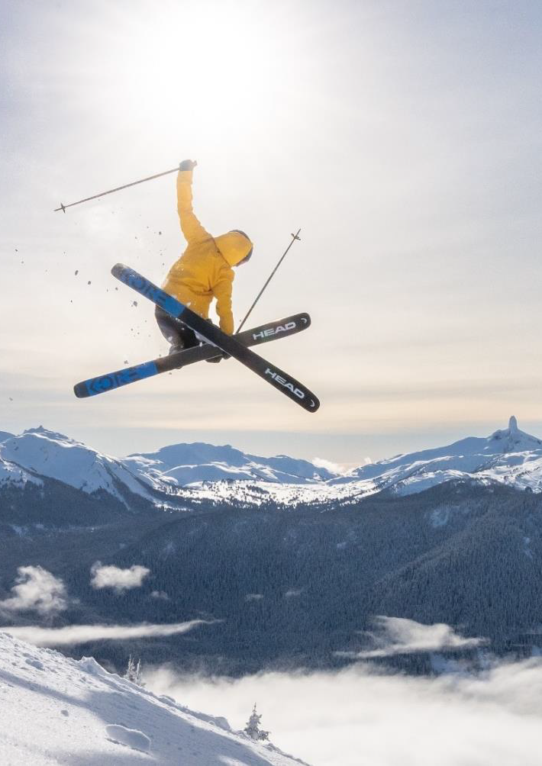
Company Overview Vail Resorts Inc.
Vail Resorts, Inc., headquartered in Broomfield, Colorado, is a leading global mountain resort operator and a prominent player in luxury, destination-based travel. The company operates through three primary segments: Mountain, Lodging, and Real Estate.
Mountain segment includes 42 owned and operated mountain resorts across North America, Australia, and Europe. Examples include Vail, Breckenridge, Whistler Blackcomb
Epic Pass program offers access to numerous other partner resorts worldwide; Vail Resorts is a major player in the multi-resort pass market
Lodging segment includes managing and owning hotels, condominiums, and golf courses; approximately 5,300 rooms in total
Real estate segment focuses on property development and holdings in surrounding communities
Founded in the early 1960’s by Pete Seibert and Earl Eaton; it went public in 1997
Reported operating income of $491 million and net income of $230 million in FY24 with total assets of $5.7 billion
We chose this company due to a love of downhill skiing and wanting to explore the reasons behind recent significant ticket price increases.
Notes:
Its Mountain segment encompasses the ownership and operation of 42 mountain resorts across the United States, Canada, Australia, and Switzerland, including iconic properties like Vail, Beaver Creek, Breckenridge, Keystone, and Whistler Blackcomb. Through its Epic Pass program, Vail Resorts provides access to numerous partner resorts worldwide, making it a key player in the multi-resort pass market. The Lodging segment includes managing and owning hotels, condominiums, and golf courses, with its luxury hotel chain, RockResorts, contributing significantly to its brand. The Real Estate segment focuses on property development and real estate holdings within and around Vail Resorts’ communities.
Founded in the early 1960s by Pete Seibert and Earl Eaton, the company opened its first ski resort in 1962 and underwent several ownership changes before going public in 1997. In recent years, Vail Resorts has expanded its global footprint through acquisitions, including Whistler Blackcomb in 2016 and a controlling interest in Switzerland’s Andermatt-Sedrun resort in 2022. Financially, Vail Resorts reported operating income of $491 million and net income of $230 million in fiscal year 2024, with total assets of $5.70 billion. The company has committed to environmental sustainability through its “Commitment to Zero” initiative, aiming to achieve a zero net operating footprint by 2030.

Slide 3
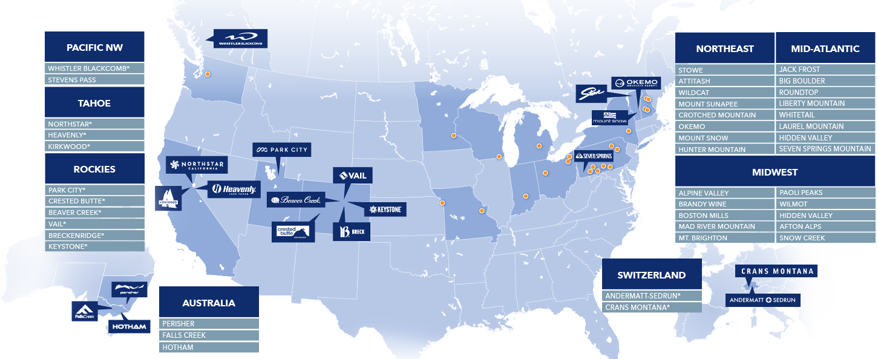
Overview – Global Footprint

Slide 4

Identify the Questions
1) Revenue Diversification
How diversified is Vail Resorts’ revenue across its business segments (lift tickets, lodging, retail, dining)?
Are some segments growing faster than others, and how does this affect overall financial stability?
2) Effective Ticket Price vs. Inflation & Skier visits
Is the increase in effective ticket price outpacing inflation?
How does this affect skier visits and overall customer accessibility?
3) Capital Expenditures & ROI
Are Vail Resorts’ capital investments (e.g., new lifts, snowmaking equipment) generating sufficient returns?

Slide 5
Hypotheses
1) Revenue Diversification
We believe that Vail Resort’s mountain segment will be its largest segment.
2) Effective Ticket Price vs. Inflation
We believe that ETP will outpace inflation and that higher ticket prices will be negatively correlated with overall skier visits.
3) Capital Expenditures & ROI
We believe that capital expenditure will be positively correlated with revenue.

Slide 6
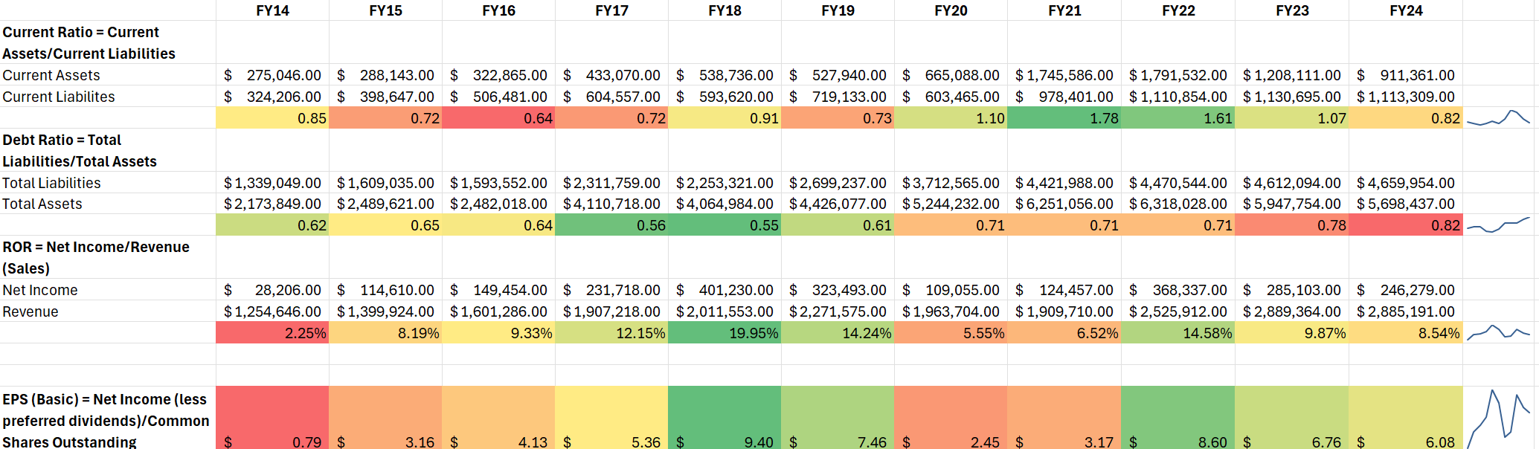
Horizontal & Vertical Analysis
Notes:
Average Ratio for the Amusement and Recreation Services Industry
Current: .94
Debt Ratio: .84
ROR: 2.1%

Slide 7

Master the Data
1) Revenue Diversification
Source: Vail Resorts’ 10-K filings (segment reporting sections).
Key Metrics: Revenue by segment, total revenue, and percentage contribution of each segment over time.
2) Effective Ticket Price vs. Inflation & Total Skier Visits
Source: Lift ticket revenue and skier visits from 10-K filings; historical inflation data (CPI)
Key Metrics: Effective ticket price (revenue ÷ skier visits), inflation adjusted ticket price, and skier visit trends.
3) Capital Expenditure & ROI
Source: Capital expenditure figures from cash flow statements, revenue, and skier visits.
Key Metrics: Capital expenditure, revenue change per dollar of investment, skier visit changes.
Notes:
10K's from SEC website (Inludes the financial data and the Skier data
CPI (Consumer Price Index)

Slide 8
Perform Test Plan
1) Revenue Diversification
Use a time-series analysis to track revenue trends by segment.
Perform a percentage breakdown of each segment’s contribution to total revenue.
Highlight segments showing consistent growth or decline.
2) Effective Ticket Price vs. Inflation
Adjust historical ticket prices for inflation and compare them with actual price increases.
Analyze skier visit trends to see if higher prices impact visitation rates.
Use correlation analysis to determine the relationship between price increases and skier visits.
3) Capital Expenditures & ROI
Identify significant capital expenditure periods and corresponding revenue and skier visit trends.
Calculate ROI for capital investments by comparing revenue per skier and total net revenue.
Notes:
Discuss methods used

Slide 9
Address and Refine Results
1) Revenue Diversification
Compare the growth rates of different segments.
Identify underperforming or over-reliant segments and discuss potential risks or opportunities for diversification.
2) Effective Ticket Price vs. Inflation
Evaluate whether pricing aligns with operational costs and inflation.
Assess whether price increases risk alienating customers or impacting skier volume.
3) Capital Investment & ROI
Highlight investments that significantly improve revenue or skier visits.
Identify underperforming investments and recommend future capital allocation strategies.

Slide 10

Communicate Insights
Notes:
Discuss findings and recommendations based on analysis
1) Revenue Diversification
Visuals: Stacked bar charts or pie charts to show revenue composition over time.
Narrative: Explain which segments are driving growth and which need strategic attention.
2) Effective Ticket Price vs. Inflation
Visuals: Line charts comparing effective ticket price, inflation-adjusted ticket price, and skier visits over time.
Narrative: Discuss whether pricing aligns with inflation and customer expectations.
3) Capital Expenditure & ROI
Visuals: ROI charts comparing different investment categories, time-series graphs of CapEx vs. revenue.
Narrative: Provide actionable insights on capital spending priorities and expected ROI.

Slide 11
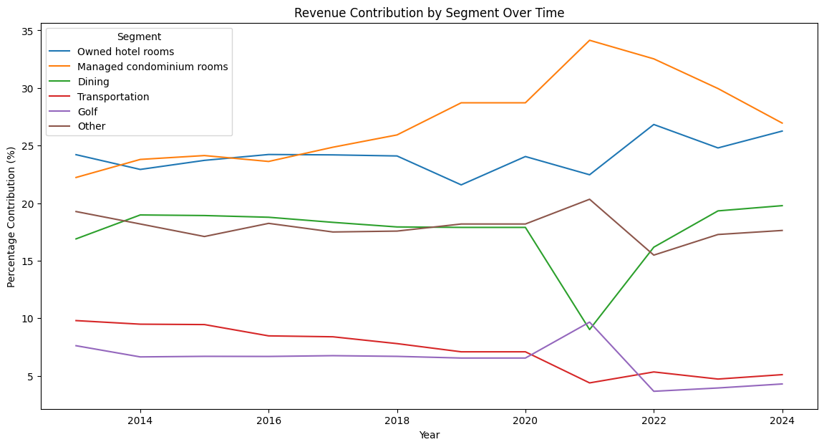
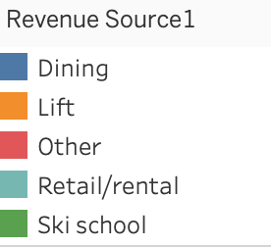
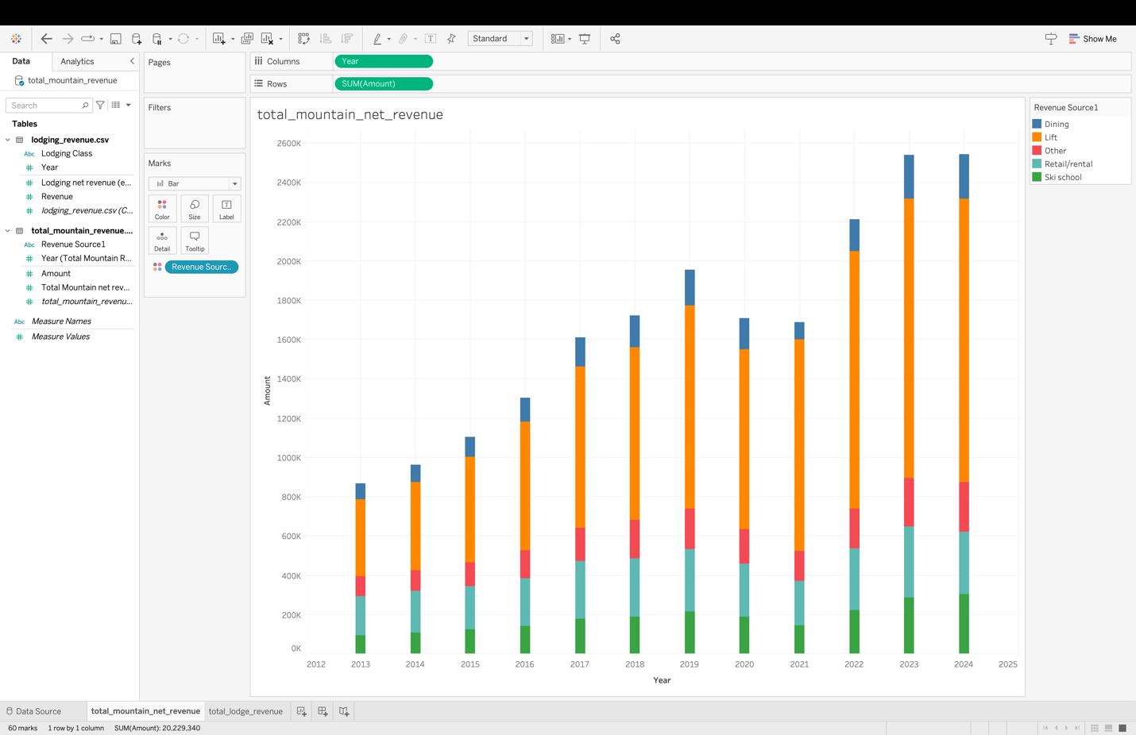
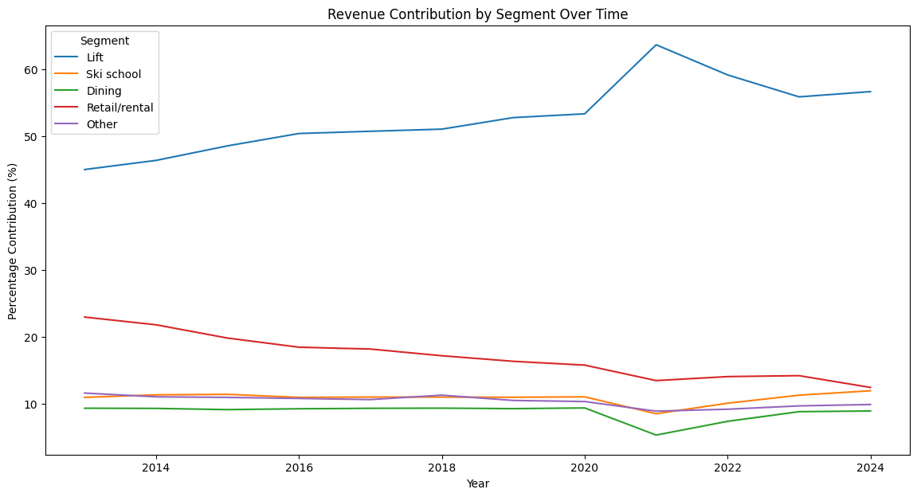
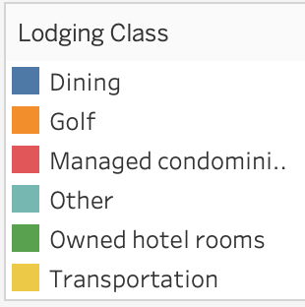
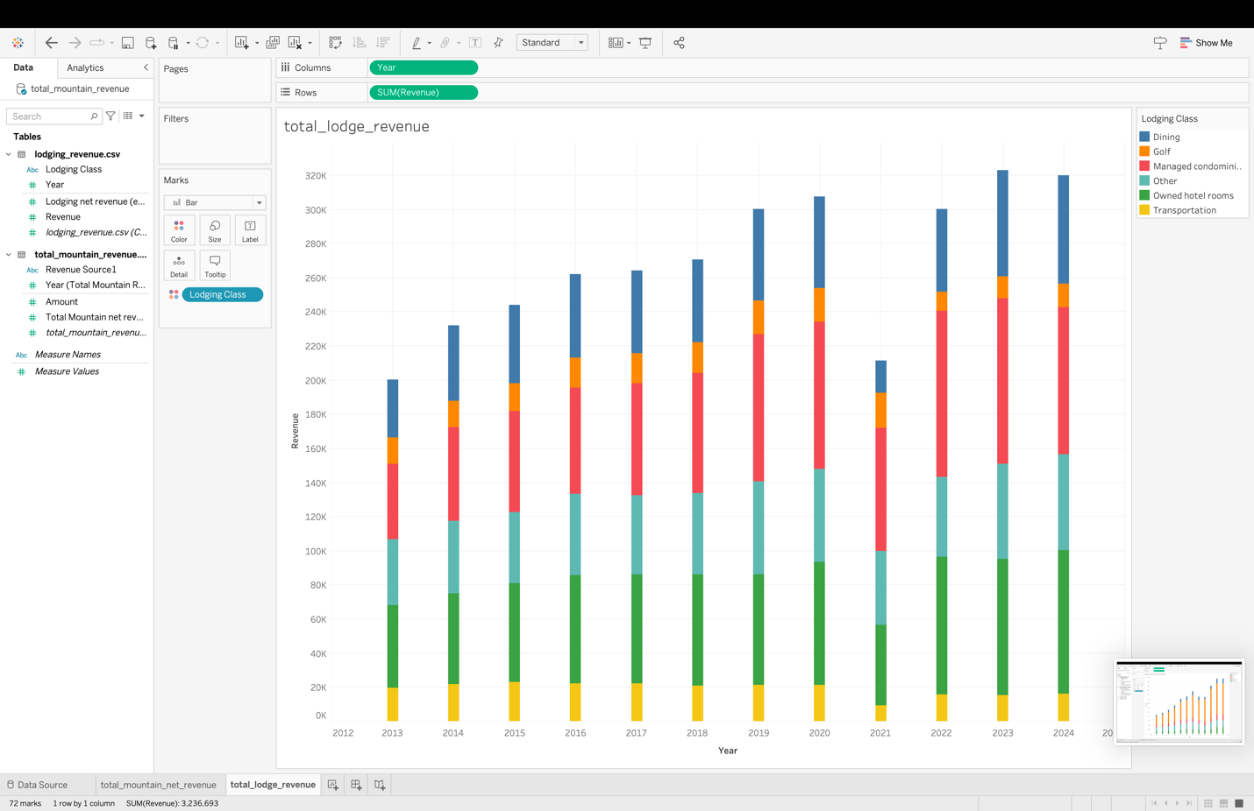
Revenue Diversification

Slide 12
Revenue Diversification

Slide 13
Revenue Diversification

Slide 14
Revenue Trends and Performance Across Segments (2013-2023)
Lodging
Hotel Room Sales: The biggest source of revenue in 2013, starting at 24.21% and increasing after 2014, staying quite steady with some small fluctuations but overall experiencing growth.
Condo Room Sales: Grew a lot starting in 2015, becoming a bigger part of the total revenue. Started to decline after the big high of 2021.
Dining: Started at 16.89% in 2013. Went up and down, with a big drop in 2020 due to COVID-19. After 2020, it almost immediately came back to where it was the year before.
Transportation: Made up 9.79% in 2013. Revenue from transportation fluctuated quite a lot, leaning towards more negative growth, but starting to crawl back up.
Golf: Made up 7.61% in 2013. Revenue stayed steady, with a high peak in 2021 and a big drop in 2022.
Other Sources: Includes events and activities, quite consistent with a drop in 2021.
Mountain Segment
Lift Revenue: Started at 45.05% in 2013 and steadily increased until 2023, where it had a small dip.
Ski School Revenue: Began at 10.98% in 2013, gradually increased over the years, and reached its peak in 2023, with a slight drop in 2016.
Dining Revenue: Started at 9.36% in 2013, had ups and downs, dropped significantly in 2020 due to COVID-19, and rebounded with strong growth in 2023.
Retail/Rental Revenue: Started at 22.99% in 2013, declined until 2017, then grew slightly with fluctuations, and picked up more in 2022 and 2023.
Other Revenue (Events and Activities): Included events and activities with inconsistent revenue, showing some highs and lows but peaking in 2022 and 2023.

Slide 15
Effective Ticket Price vs Skier Visits

Slide 16
Effective Ticket Price vs Inflation
Adjustment Factor:
Base Year CPI / Current Year CPI
Adjusted Ticket Price:
ETP * Adjustment Factor

Slide 17
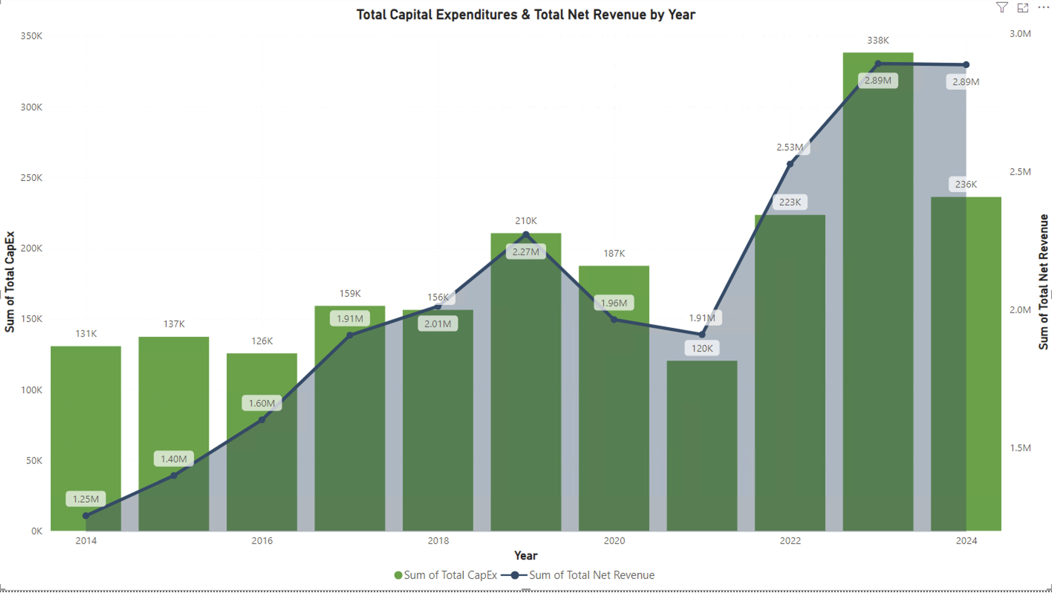
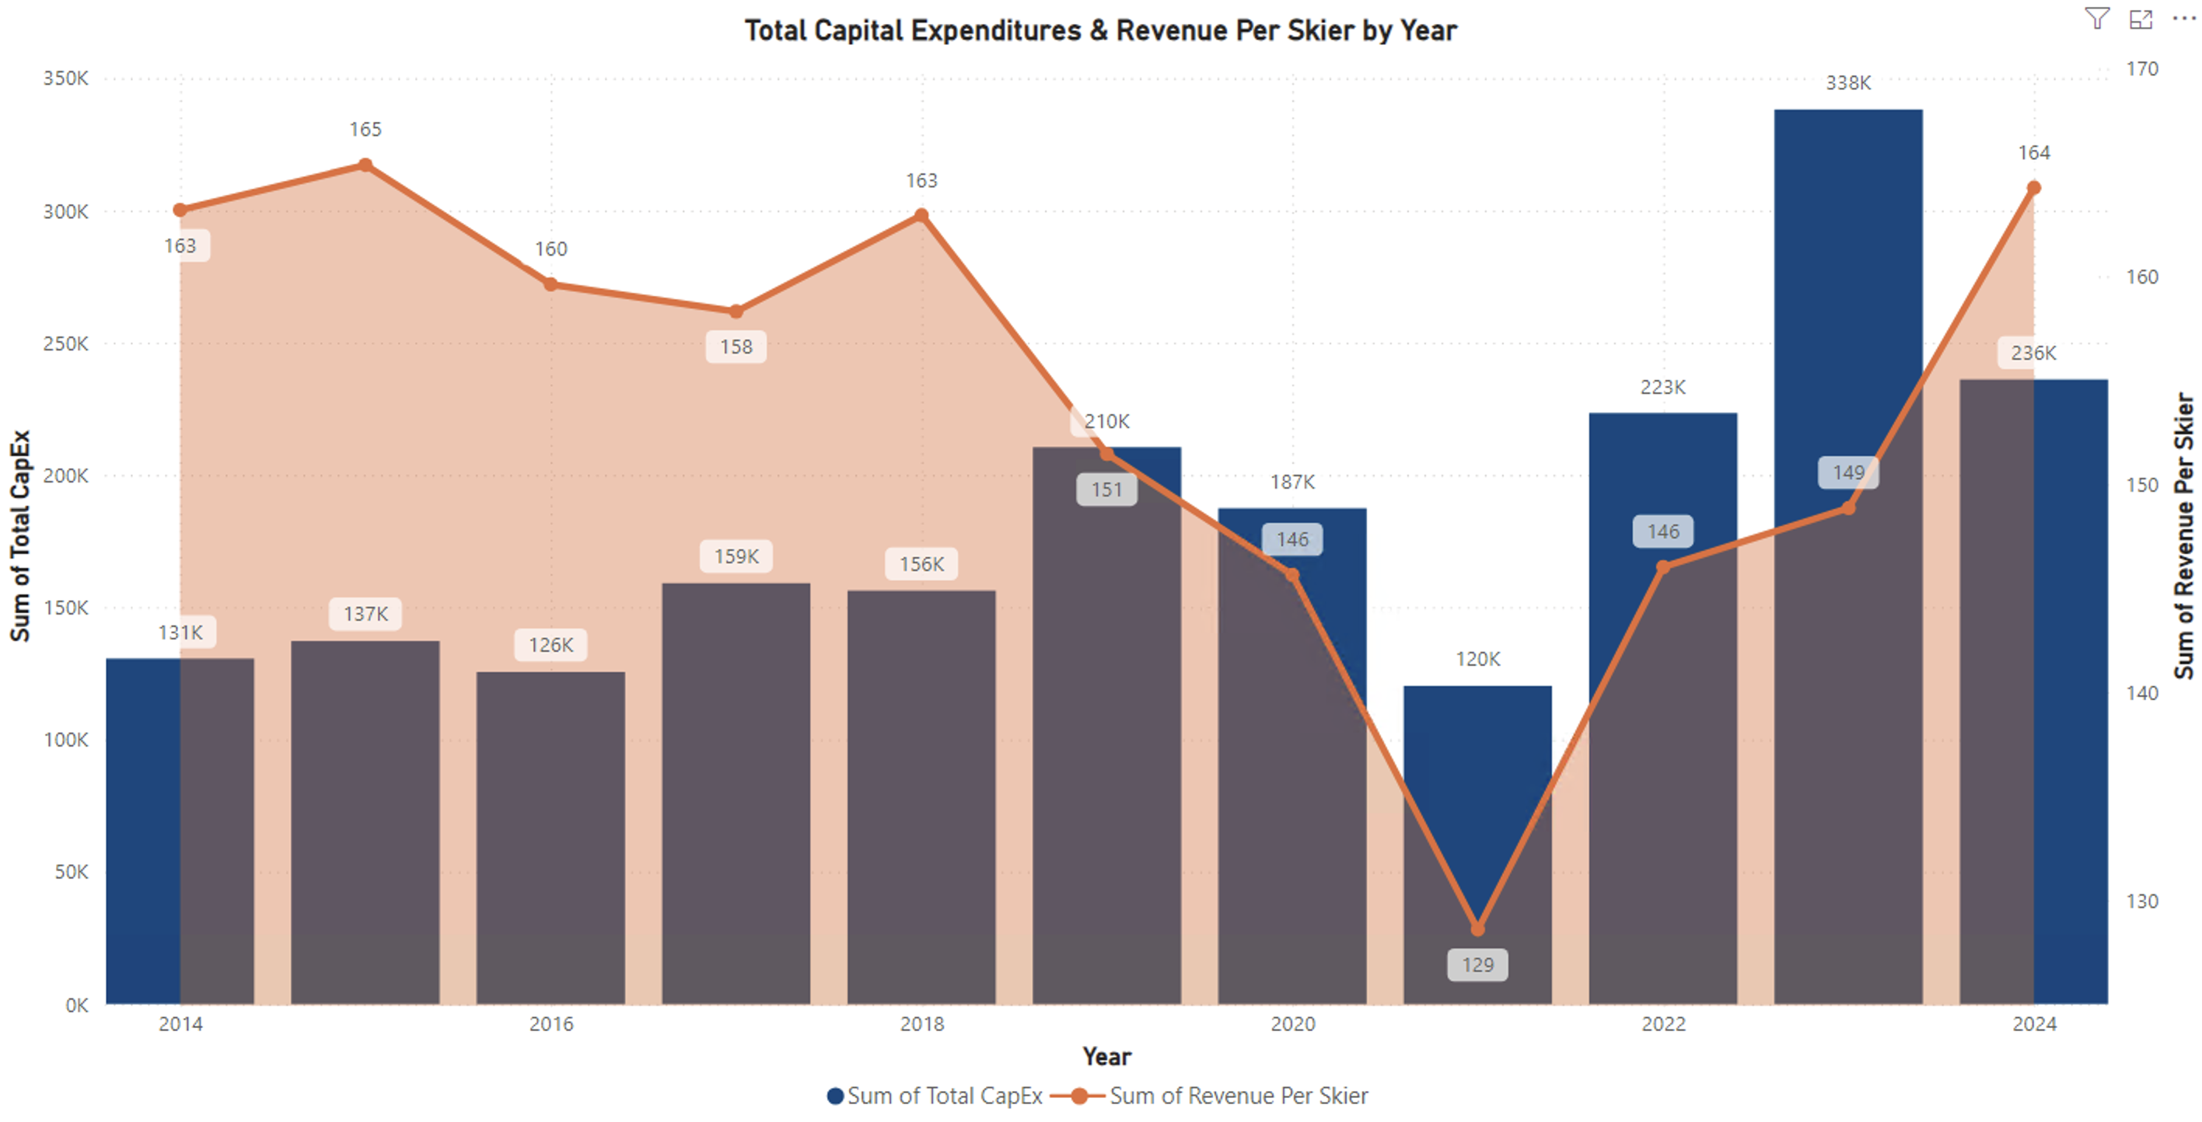
Capital Expenditures & ROI

Slide 18
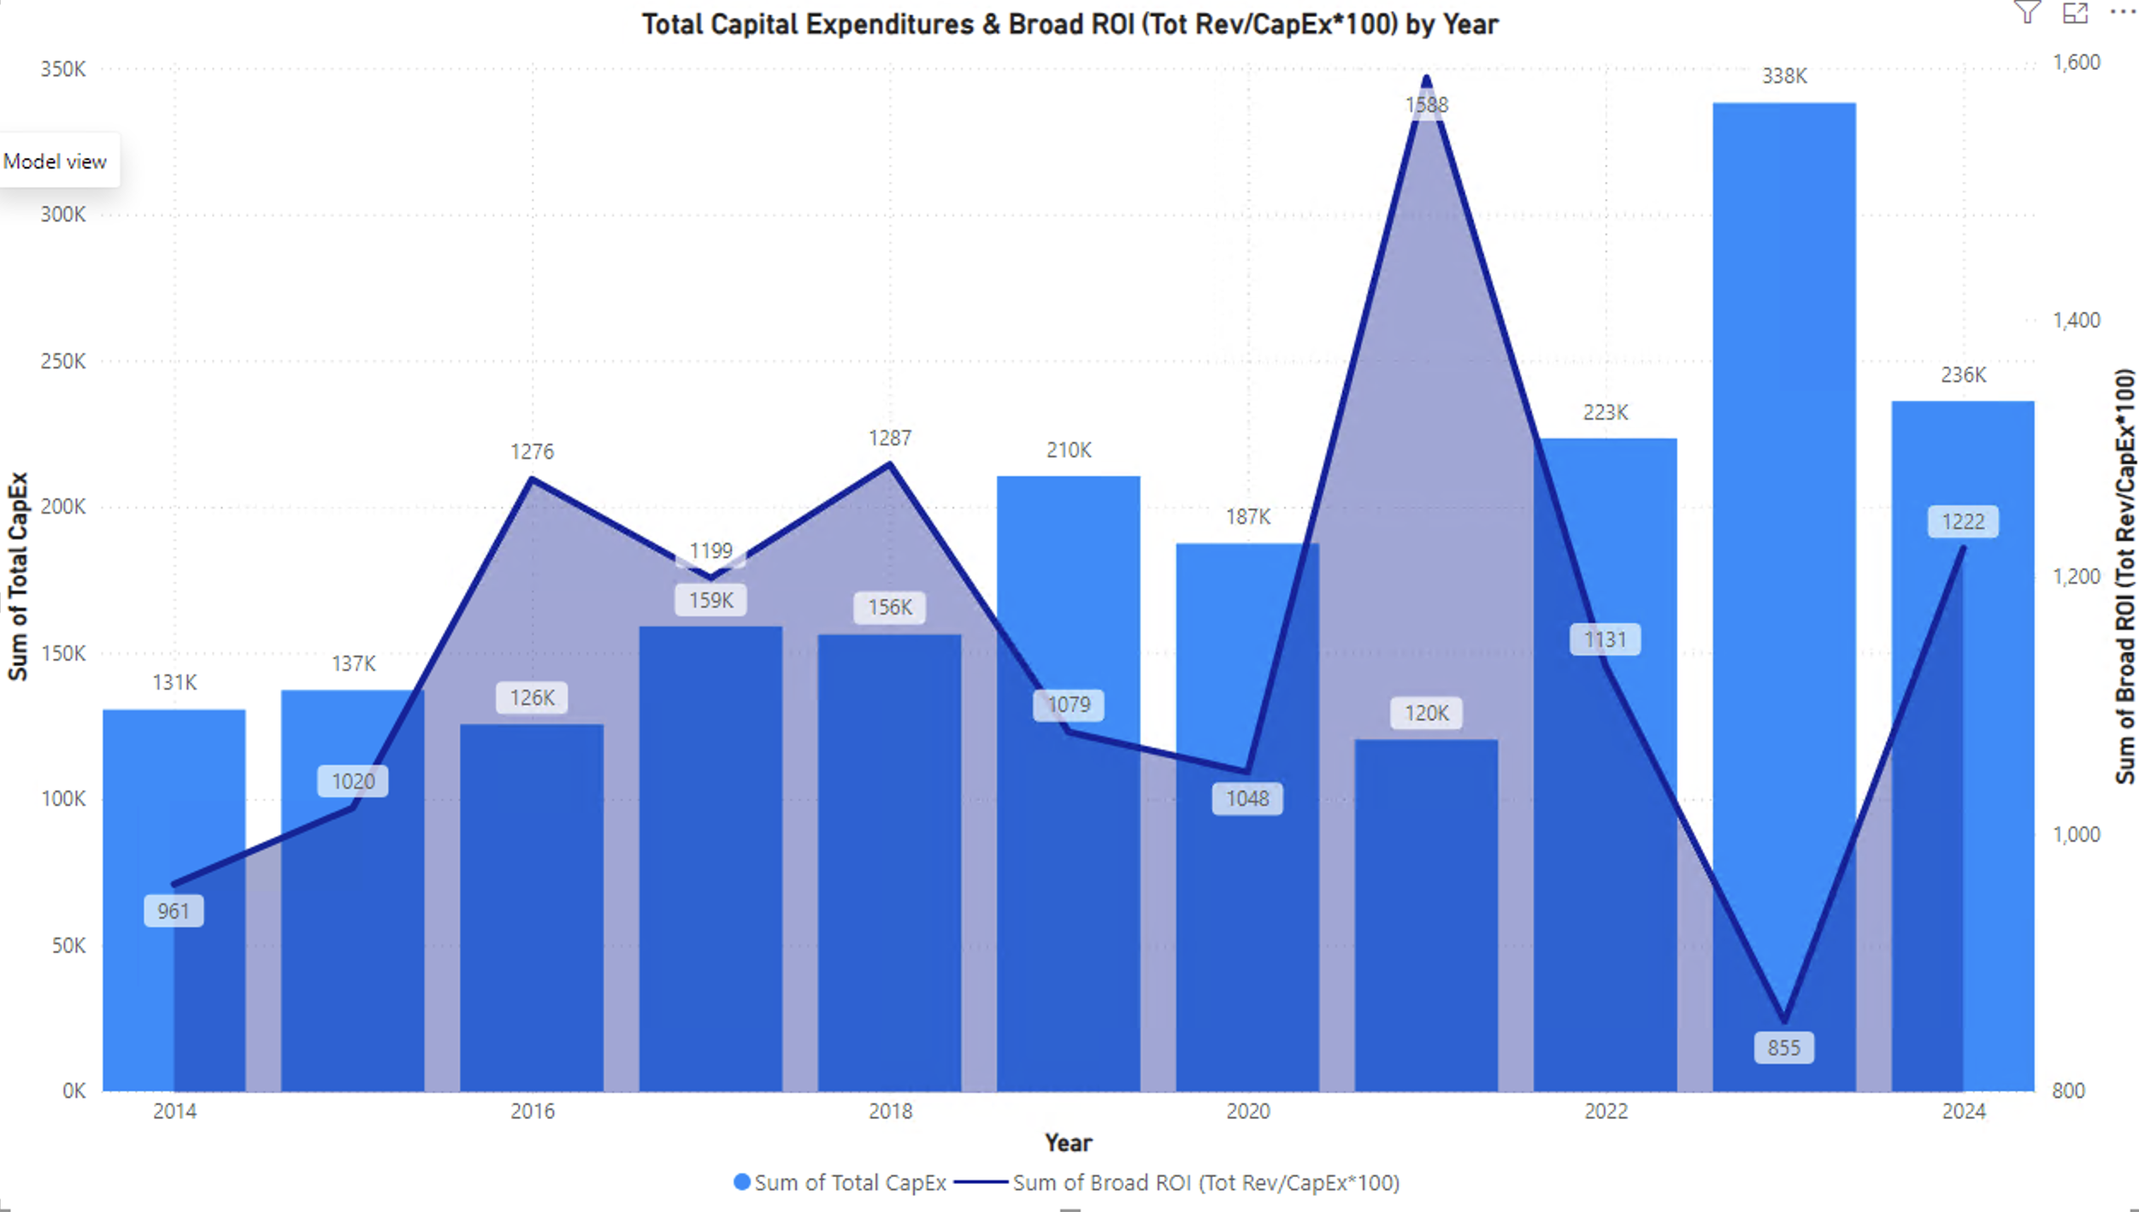
Capital Expenditures & ROI

Slide 19
Track Outcomes
Revenue Diversification
Monitor segment-specific revenue growth rates quarterly or annually to assess the impact of diversification strategies.
Effective Ticket Price vs. Inflation
Monitor effective ticket prices vs. inflation annually and track skier visits to identify trends or risks.
Capital Expenditures & ROI
Suggest tracking ROI for major investments annually to assess their long-term impact.
Notes:
?? Not sure if we would be able to build a dashboard that would effectively allow someone to track these.

Slide 20
Summary of Findings
Revenue Diversification: Vail Resorts earns money from many different areas, including mountain services, lodging, and other activities. Lift tickets and condo rentals have been the biggest contributors to growth, showing the company’s strength in its main business.
Revenue from dining and retail dropped during COVID-19 but quickly bounced back, showing the business is strong. By generating income from different sources, Vail Resorts reduces risk and can adapt to changes. This will help them continue their long-term success.

Slide 21

Questions?

Slide 22
Sources
https://investors.vailresorts.com
https://advantage.marketline.com/Company/Summary/vail-resorts-inc
https://www.mergentintellect.com/index.php/search/companyFinancials/796192243
https://quickfs.net/company/MTN:US
https://www.sec.gov/edgar/browse/?CIK=812011&owner=exclude
https://www.bls.gov/cpi/tables/supplemental-files/historical-cpi-u-202312.pdf
https://ycharts.com/indicators/us_consumer_price_index
https://www.readyratios.com/sec/industry/79/

